Slide 1

Oracles
From Ground Truth to Market Manipulation
Mehdi Salehi

Slide 2

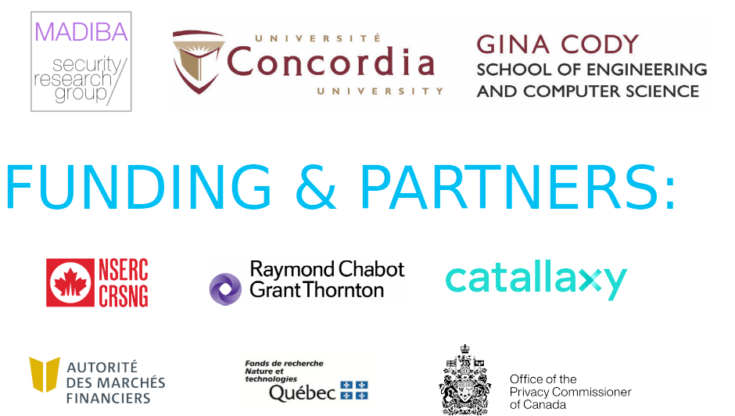
SoK: Oracles From Ground Truth to Market Manipulation

Slide 3
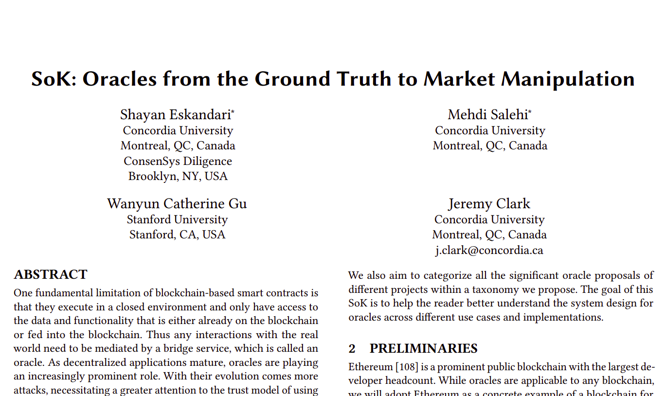
Systematization of Knowledge(SoK)
A specialized modular framework to analyze oracles
Systemize the design alternatives for oracles
Attacks and mitigation strategies
How to rethink oracle design

Slide 4
What is an Oracle?
An oracle is a bridge or gateway that connects the off-chain
real world knowledge and the on-chain blockchain network.

Slide 5


What is an Oracle?
Send 1 ETH

Slide 6
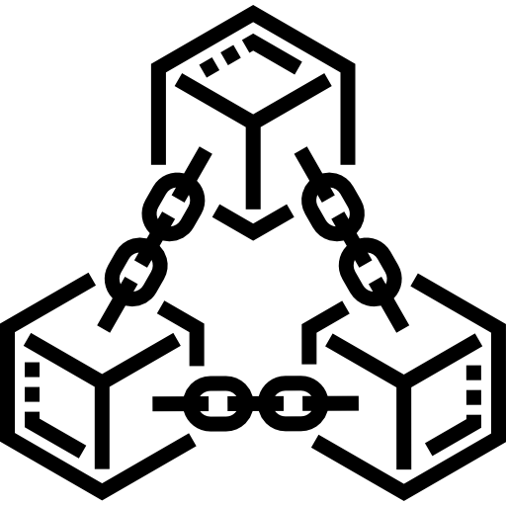
What is an Oracle?
Transaction
Transfer ETH to Bob

Slide 7


What is an Oracle?
Reduce Alice’s Balance
Increase Bob’s Balance
Transaction
Transfer ETH to Bob

Slide 8
What is an Oracle?
Transaction
Transfer ETH to Bob
Each node can validate it because it’s reproducible by each node

Slide 9
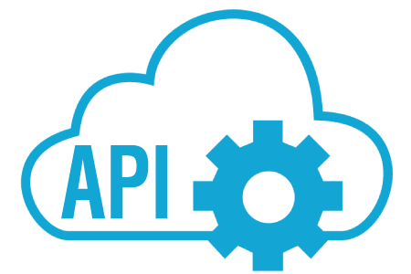
What is an Oracle?
Report Price of ETH

Slide 10
What is an Oracle?
Report Price of ETH

Slide 11

What is an Oracle?
Not Reproducible
Report Price of ETH

Slide 12
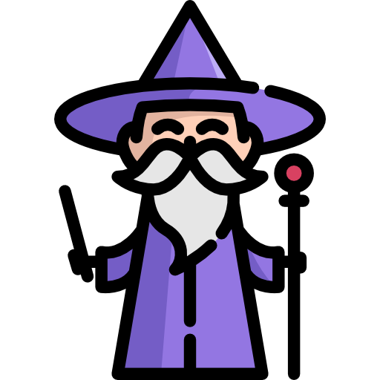
What is an Oracle?
Push Reliable Data

Slide 13
What is an Oracle?
An oracle is a bridge or gateway that connects the off-chain
real world knowledge and the on-chain blockchain network.
The Oracle Problem is real & still an open problem.

Slide 14
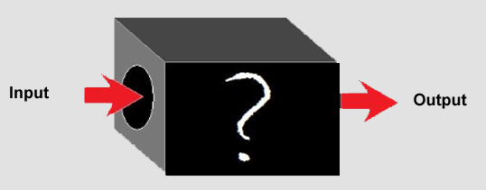
How to Systemize it?!
Previous Works:
Think of it as black box
Systemize it based of Input, Outputs, function
Didn’t dive into the Details enough

Slide 15

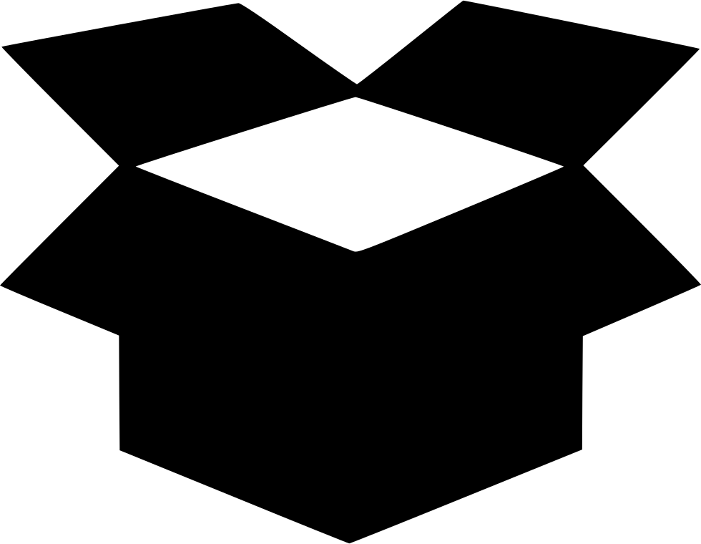

How to Systemize it?!
Components

Slide 16
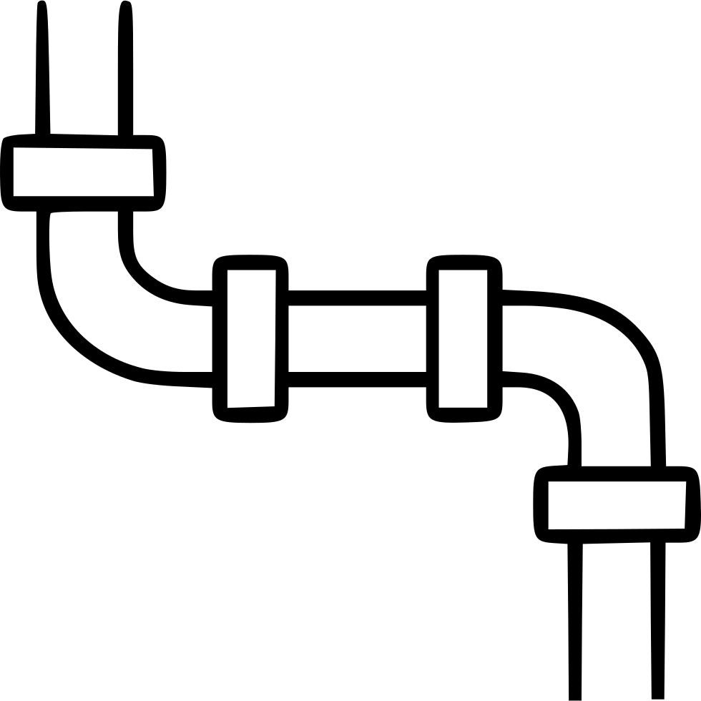
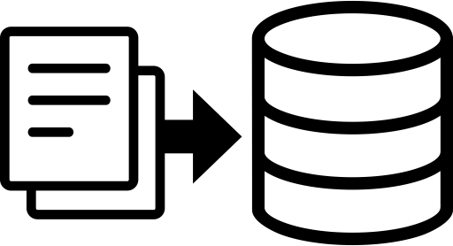
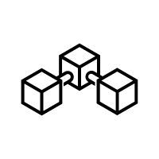
How to Systemize it?!
Put myself on Data’s shoes
Blockchain

Slide 17
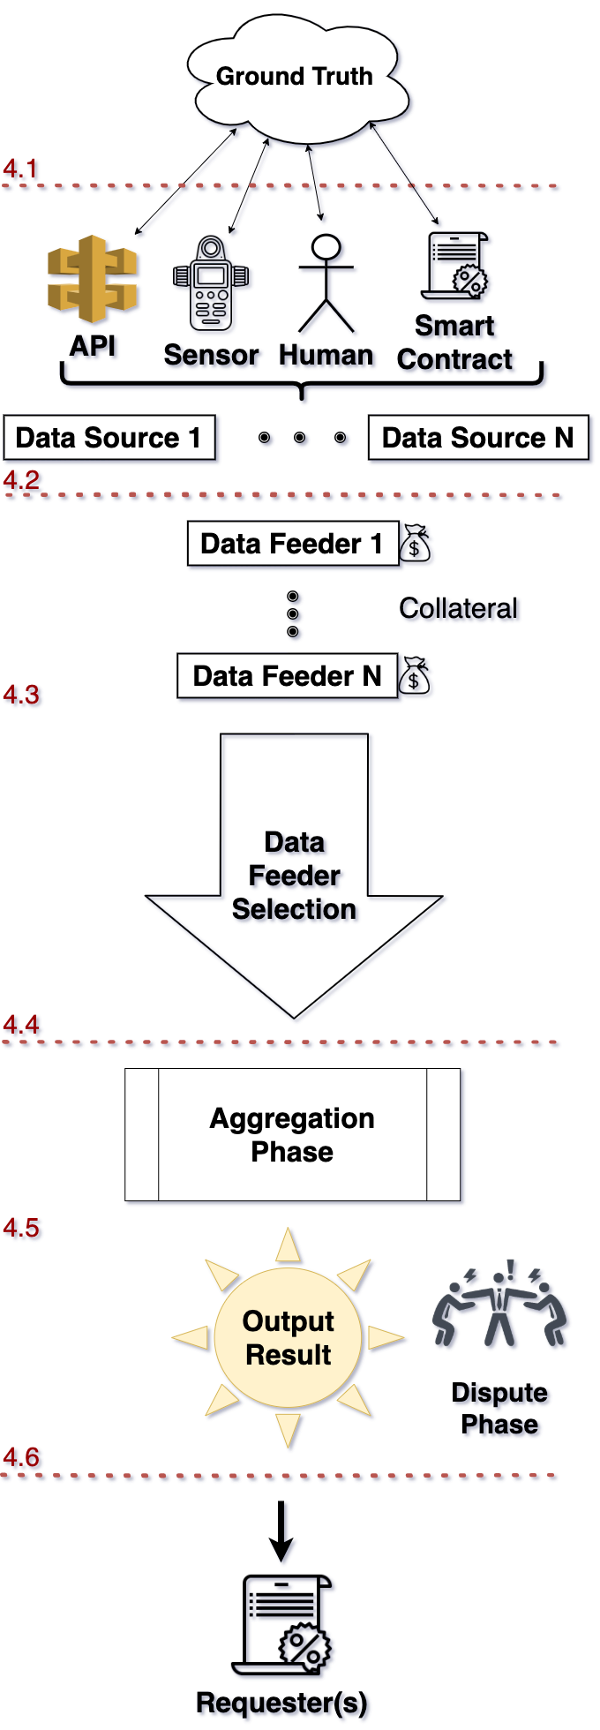
Oracle’s Modular Workflow
We break the design of an oracle system into modules
Each module can be on-chain or off-chain, or in
different order. But all oracles can be defined using
these modules

Slide 18
Oracle’s Modular Workflow
Ground Truth
Data Sources
Data Feeders
Selection of Data Feeders
Aggregation
Dispute Phase

Slide 19
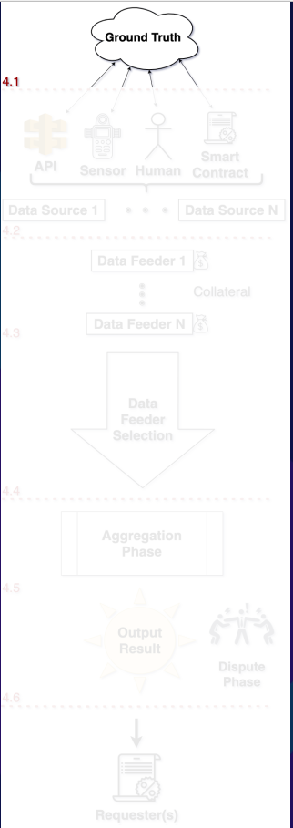
Ground Truth
The first challenge of an oracle designer starts with a philosophical question:
What is the truth?
Is the truth objective or subjective?
We try to solve:
What is the best way to collect raw data from sources and aggregate them to have a reasonable data quality?

Slide 20
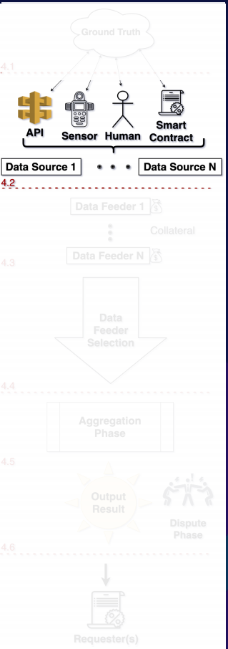
Data Sources
Passive entities that store and measure the representation of the ground truth.
Common types of data sources include:
Databases & API
Sensors
Humans
Smart contracts or a combination of them

Slide 21
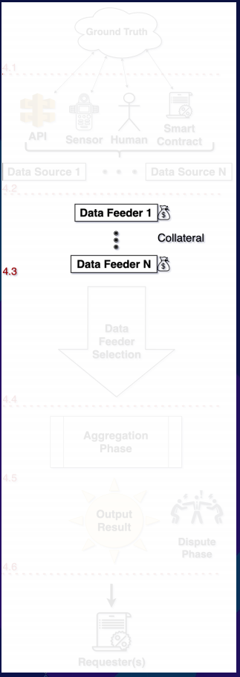
Data Feeders
Entities who gather and report the data from the source to the oracle system
Security Provisions:
Source Authentication
DECO, TLSNotary — HTTPS Data
TownCrier — Intel SGX
Confidentiality
Non-Repudiation

Slide 22
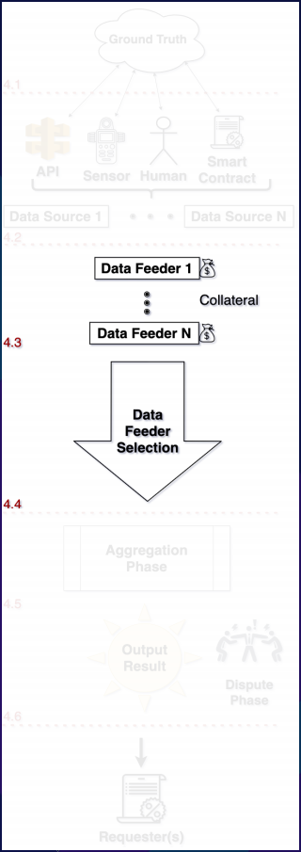
Selection of Data Feeders
Select legitimate data feeders and weed out the less
qualified participants
Centralized (Allowlist) Selection
Decentralized (Allowlist) Selection
Voting
Staking
+Random

Slide 23
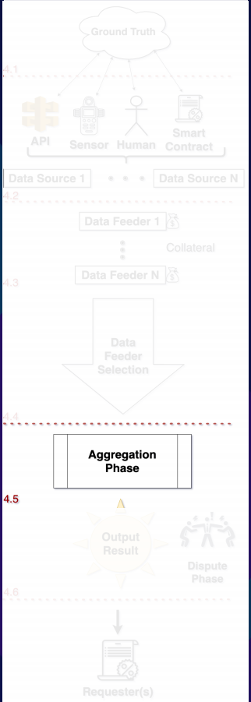
Aggregation Phase
The process of synthesizing the selected data feeds into one single output
Statistical Measures
Mean / Median / etc
Weighting methods (Time, Volume, etc)
Random selection
Expiration Date and Stale Data

Slide 24
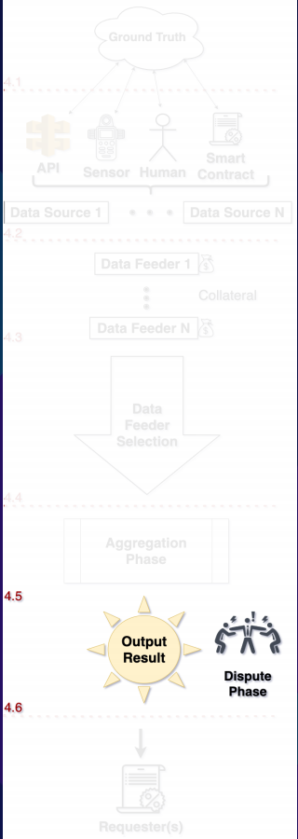
Dispute Phase
Safeguards the quality of the final output and give the
stakeholders a chance to mitigate inclusion
of wrong data
Provider-level v.s.
Data-level Vetting

Slide 25
Dispute Phase
Determining the Truth
Statistical approach (+ Stake)
Voting (+ Stake)
Arbitrage (For exchange rates between two on-chain tokens)

Slide 26
Dispute Phase
Consequences for Incorrect Data
Revert or Correct
Impacts finality of data
Consequences for Data Feeder
banned, slashed, reputation loss, or no consequence

Slide 27
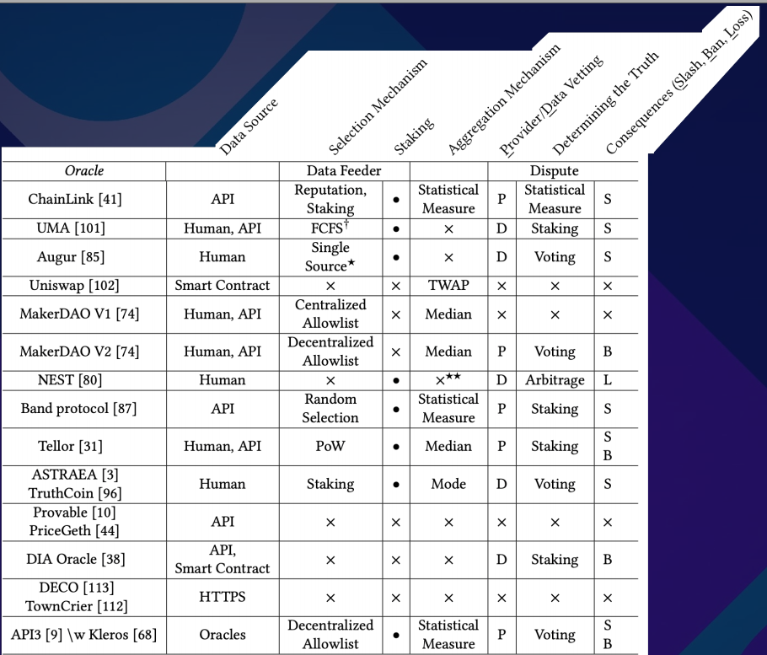
Classification of the current Oracles

Slide 28

Now the dark forest
Interacting with Blockchain
Off-chain Infrastructure
Blockchain Infrastructure
Smart Contracts
Oracle
Data Consumer

Slide 29
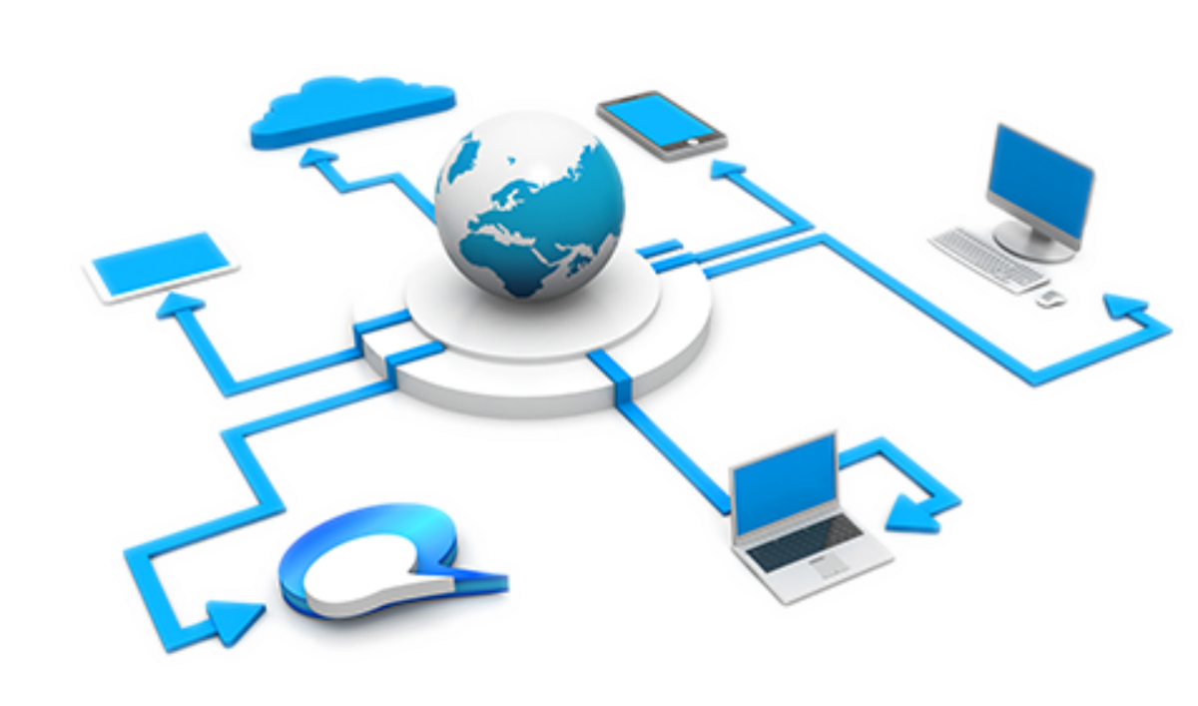
Off-chain Infrastructure
Monitoring the Blockchain (for request- response oracles)
Connection to Data Source
Data Feeders Network
Transaction Creation
Secure private key & signing
Positive balance for gas
Dynamic gas fee

Slide 30
Blockchain Infrastructure
Blockchain Node
Synced and available
Block Creation
Front-running attacks
MEV
Consensus
Uncle Blocks (EtherRoll reorg attack)

Slide 31
Shower Thoughts
Oracles use their governance token for Staking, two necessary conditions:
The market capitalization of the token stays material
The token is evenly distributed.

Slide 32
Shower Thoughts
Oracles use their governance token for Staking, two necessary conditions:
The market capitalization of the token stays material
The token is evenly distributed.
How to incentivize on-chain oracles for use-cases with no direct revenue? (Weather data)

Slide 33
Shower Thoughts
Oracles use their governance token for Staking, two necessary conditions:
The market capitalization of the token stays material
The token is evenly distributed.
How to incentivize on-chain oracles for use-cases with no direct revenue? (Weather data)
Diversity in software promotes resilience in the system. If one project is the main Oracle, failure within that one project causes cascading failure across the ecosystem

Slide 34
Shower Thoughts
One can never capture the full extent of Profit from Corruption

Slide 35


Thanks!
Do you have any questions?
me_alehi@encs.concordia.ca
@Greatsaoshyant
https://arxiv.org/pdf/2106.00667.pdf

